Slide 1
Wednesday

Slide 2
Course Logistics
Problem Set 1 – Due Wednesday, February 8
Weekly Activity – Jupyter Notebook uploaded – submit Notebook on Canvas
Project Milestone 1 – Due Friday, Feb. 3

Slide 3
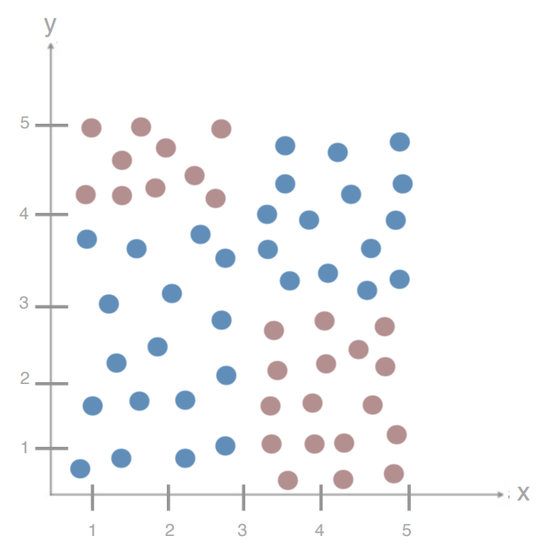
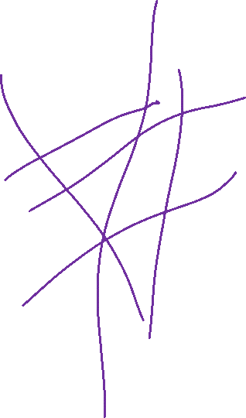
Intuition
Let’s build a few “bad” models
Let’s then combine the predictions!
Let’s add even more “bad” models!

Slide 4
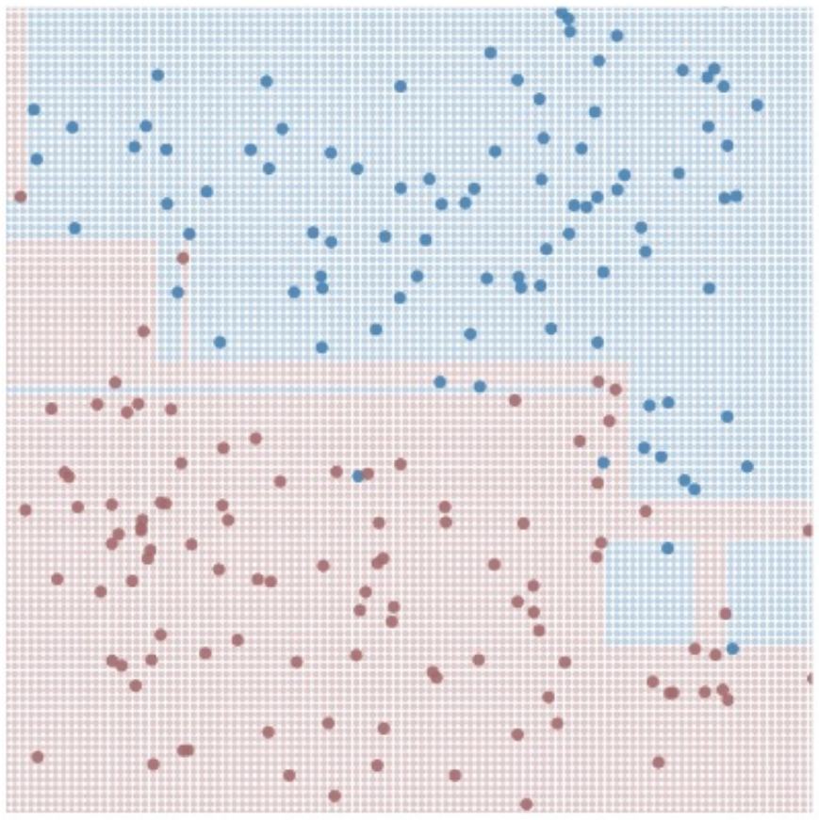
Building “Dumb” Models – Bagging (Bootstrap Aggregating)
TRAINING
For M (# Models) iterations:
Select N points with replacement
Train a decision tree
Hang on to that decision tree
TESTING
For each test point:
Ask all the decision trees what decision to make
Accept Y (the best answer)

Slide 5
Bagging - Benefits

Slide 6
Bagging - Benefits
Reducing the variance (overfitting)?

Slide 7
Bagging - Benefits
Reducing the variance (overfitting)
Variance – Sensitivity to the training set
Yes

Slide 8
Bagging - Benefits
Reducing the variance (overfitting)
Variance – Sensitivity to the training set
Yes
Reducing the bias (underfitting)?

Slide 9
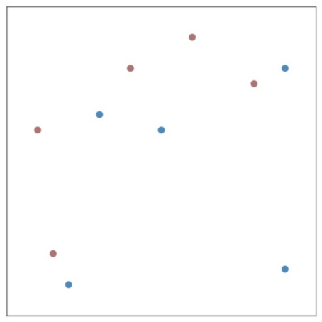
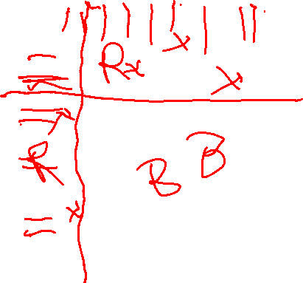
Weights for Individual Classifiers

Slide 10
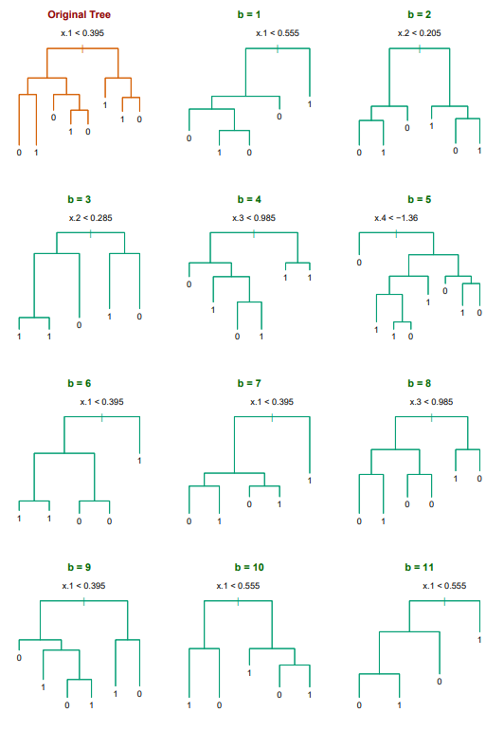
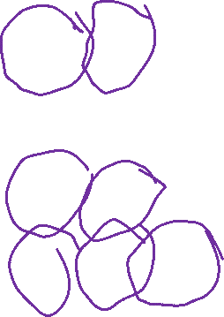
Ensemble Learning - Improvements
We have aggregated models helping reduce the variance, but how can we reduce the bias?
Bias – Sensitivity to the model
Looking at some example trees…

Slide 11
Bagging - Benefits
Reducing the variance (overfitting)
Variance – Sensitivity to the training set
Yes
Reducing the bias (underfitting)
Bias – Sensitivity to the model
No

Slide 12
Ensemble Learning - Improvements
We have aggregated models helping reduce the variance, but how can we reduce the bias?
Bias – Sensitivity to the model

Slide 13
Ensemble Learning – Reducing Bias
The trees are demonstrating high correlation
- Many of our trees are using an identical splitting point for the first decision!
- This correlation is a source of bias
We need to force the trees to care about different features

Slide 14
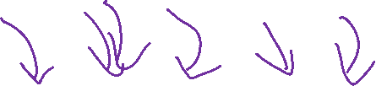
Ensemble Learning – Feature Subsets
Within the bagging loop, force each split to be made based on a subset of features
X₁ | X₂ | X₃ | X₄ | X₅ | Y
Size (Sq. Ft.) | # Bed | # Bath | Year Built | Price ($) | Single Family?
1200 | 1 | 1.5 | 1998 | 200,000 | No
1800 | 2 | 2 | 1985 | 450,000 | Yes
800 | 1 | 1 | 2017 | 250,000 | No
2500 | 3 | 2 | 1975 | 500,000 | No
2800 | 4 | 2.5 | 1983 | 400,000 | Yes
… | … | … | … | …

Slide 15

Ensemble Methods– Random Forests
TRAINING
For M iterations:
Select N’ points with replacement
Train a decision tree:
For each split:
Choose F features to split on:
Choose your best split from them
Hang on to that decision tree
TESTING
For each test point:
Ask all the decision trees what decision to make
Accept Y

Slide 16
Random Forests – Choosing # Features (F)
In short – it depends!
- Treat this as a tuning parameter
- Similar to K in KNN
Sqrt(|X|) is a good
default
X₁ | X₂ | X₃ | X₄ | X₅ | Y
Size (Sq. Ft.) | # Bed | # Bath | Year Built | Price ($) | Single Family?
1200 | 1 | 1.5 | 1998 | 200,000 | No
1800 | 2 | 2 | 1985 | 450,000 | Yes
800 | 1 | 1 | 2017 | 250,000 | No
2500 | 3 | 2 | 1975 | 500,000 | No
2800 | 4 | 2.5 | 1983 | 400,000 | Yes
… | … | … | … | …

Slide 17
Ensemble Methods
We’re building all of these ideas on “Dumb” models, but surely we can do better?
The goodness comes out through aggregation, but some models may be “better” than others
- Can we try to trust these models more?

Slide 18
Boosting

Slide 19
Interlude – A Weak Learner
Assumptions – binary classification problem
both classes are 50% likely
Expectations

Slide 20
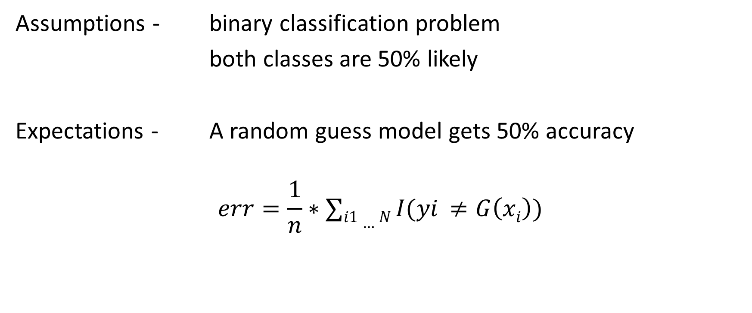
Ensemble Methods – A Weak Learner
Assumptions - binary classification problem
both classes are 50% likely
Expectations - A random guess model gets 50% accuracy
$$err=\frac{1}{n}∗∑i1…N I(yi ≠G\left(xi\right))$$

Slide 21
Ensemble Methods – A Weak Learner
Assumptions - binary classification problem
both classes are 50% likely
Expectations - A random guess model gets 50% accuracy
A “weak” learning model would perform slightly better than chance
We can only determine this through training accuracy / error

Slide 22
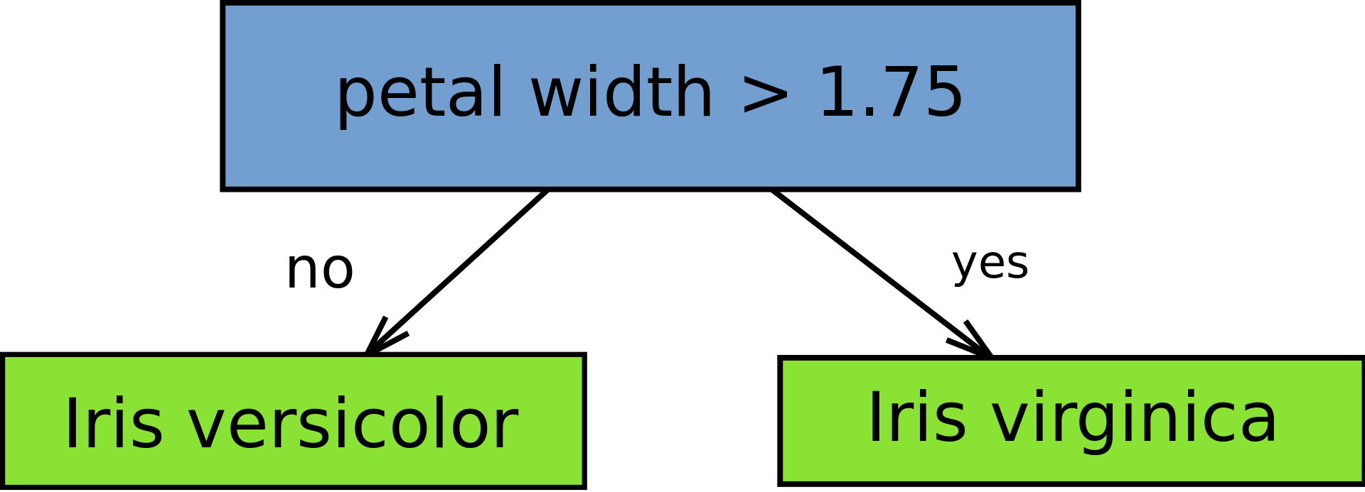
Weak Learner – Decision Stump
A 1-layer decision tree (a.k.a. a decision tree with a single split)
Entropy = -p * log₂(p) – (1-p) * log₂(1-p)
Notes:
https://en.wikipedia.org/wiki/File:Decision_stump.svg

Slide 23
Weak Learner – Decision Stump
A 1-layer decision tree (a.k.a. a decision tree with a single split)
Entropy = -p * log₂(p) – (1-p) * log₂(1-p)
This could serve as a restriction on # dimensions, tree size for random forest!
Notes:
https://en.wikipedia.org/wiki/File:Decision_stump.svg

Slide 24
Ensemble Methods - Boosting
All animals are equal, but some animals are more equal than others.
- George Orwell (Animal Farm, Chapter 10)

Slide 25
Ensemble Methods - Boosting
All animals are equal, but some animals are more equal than others.
- George Orwell (Animal Farm, Chapter 10)
All classifiers are equal, but some classifiers are more equal than others.
In an ensemble classifier, can we favor some of the individual classifiers more than others?

Slide 26
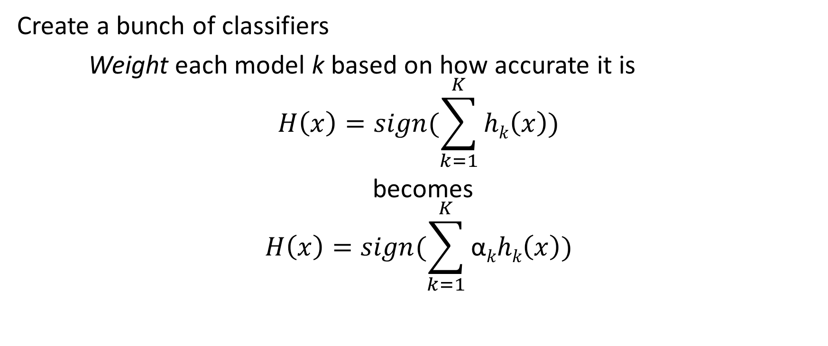
Boosting – Favoring Certain Points
Create a bunch of classifiers
Weight each model k based on how accurate it is
$$H\left(x\right)=sign(\sum_{k=1}^{K}{hk\left(x\right)})$$
becomes
$$H\left(x\right)=sign(\sum_{k=1}^{K}{\text{α}khk\left(x\right)})$$

Slide 27
Weights for Individual Classifiers

Slide 28
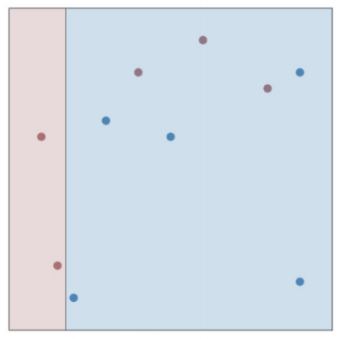
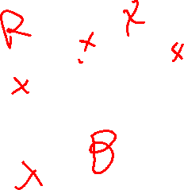
Weights for Individual Classifiers

Slide 29

Weights for Individual Classifiers
$$err= \sum_{i=1}^{m}{I(yi ≠h\left(xi\right))}$$

Slide 30

Weights for Individual Classifiers
$$err= \sum_{i=1}^{m}{I(yi ≠h\left(xi\right))}$$
Err = 3
Error range = [0, ∞]

Slide 31

Weights for Individual Classifiers
$$err= \frac{\sum_{i=1}^{m}{I(yi ≠h\left(xi\right))}}{m}$$
Err = 0.3
Error range = [0, 1]

Slide 32
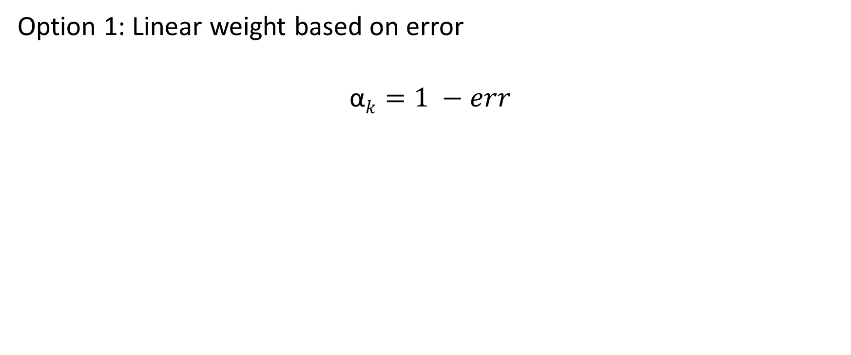
Weights for Individual Classifiers
Option 1: Linear weight based on error
$$\text{α}k=1 −err$$

Slide 33
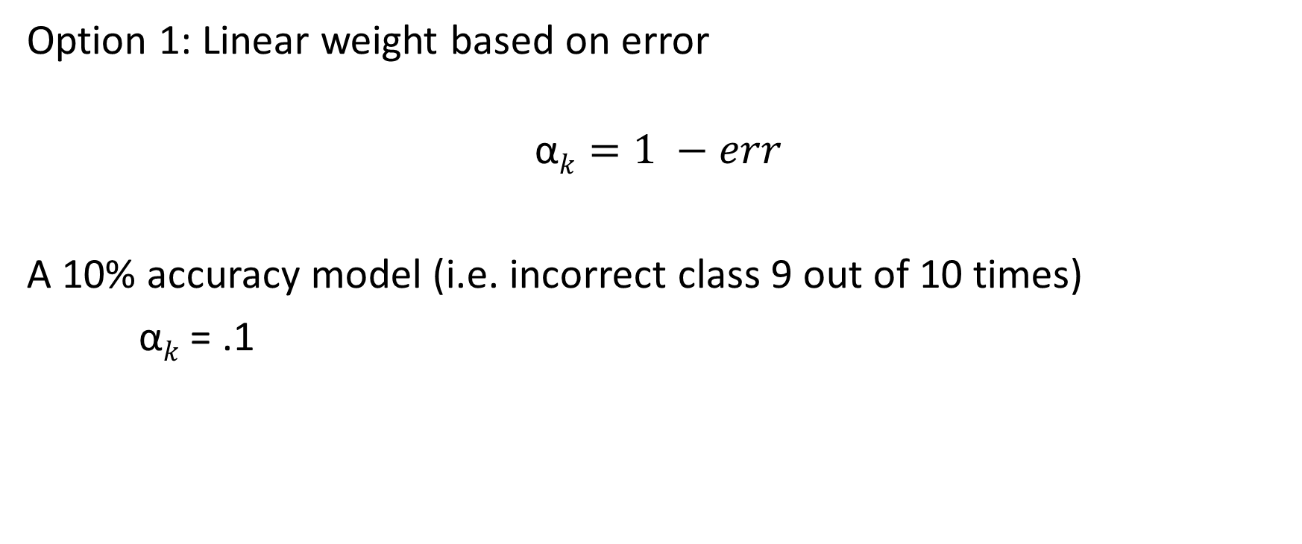
Weights for Individual Classifiers
Option 1: Linear weight based on error
$$\text{α}k=1 −err$$
A 10% accuracy model (i.e. incorrect class 9 out of 10 times)
$\text{α}k$ = .1

Slide 34
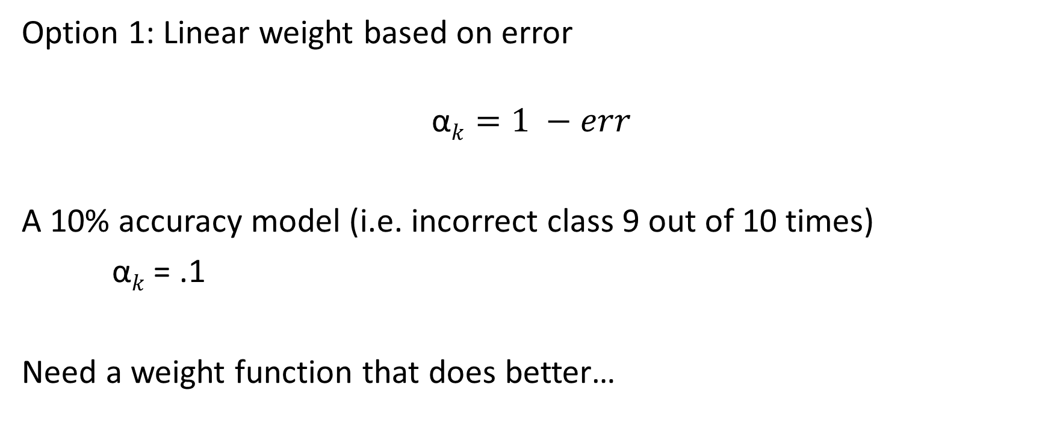
Weights for Individual Classifiers
Option 1: Linear weight based on error
$$\text{α}k=1 −err$$
A 10% accuracy model (i.e. incorrect class 9 out of 10 times)
$\text{α}k$ = .1
Need a weight function that does better…

Slide 35
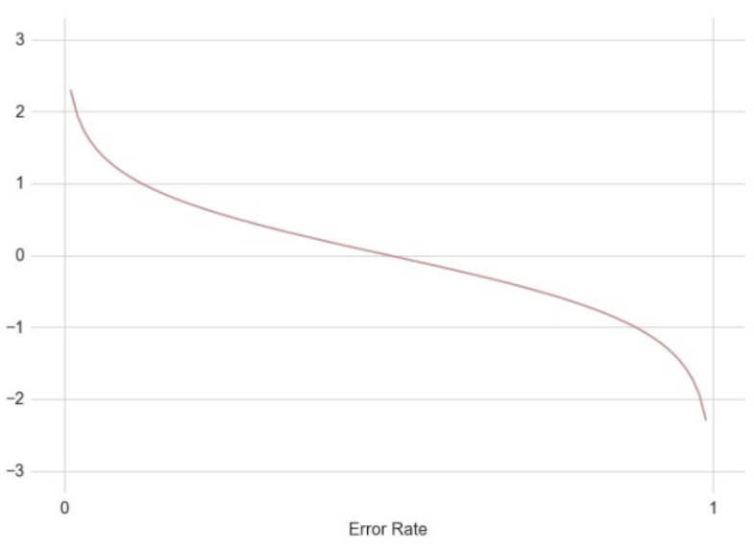

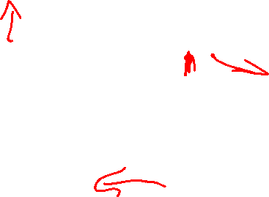
Exponential Weights for Individual Classifiers
$$\text{α}k=\frac{1}{2}\log\left(\frac{1−errk}{errk}\right)$$
Grows for low error
Approaches 0 for error .5 (chance)
Negative penalty for high error

Slide 36

Weights for Individual Classifiers
$$err= \frac{\sum_{i=1}^{m}{I(yi ≠h\left(xi\right))}}{m}$$
Err = 0.3
$$\text{α}k=\frac{1}{2}log⁡(\frac{1−{err}_{k}}{errk})$$

Slide 37
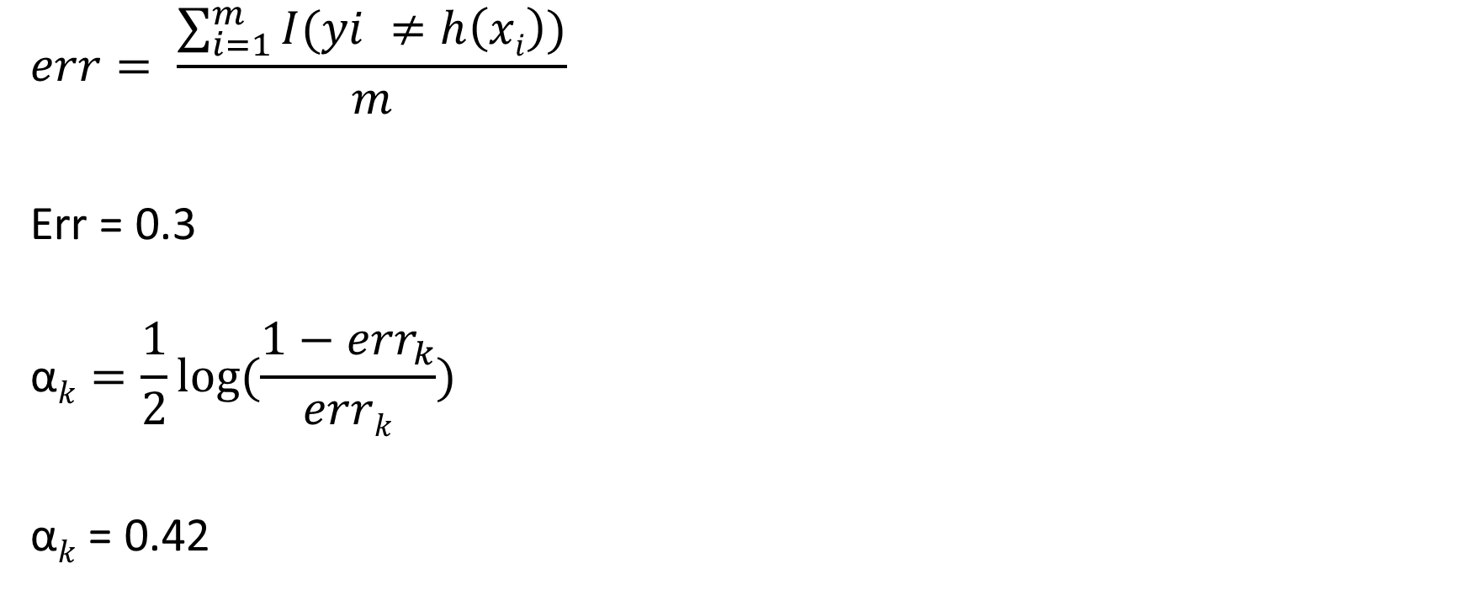
Weights for Individual Classifiers
$$err= \frac{\sum_{i=1}^{m}{I(yi ≠h\left(xi\right))}}{m}$$
Err = 0.3
$$\text{α}k=\frac{1}{2}log⁡(\frac{1−{err}_{k}}{errk})$$
$\text{α}k$ = 0.42

Slide 38
Weights for Individual Classifiers
Could we have done a better split on this model than 70% accuracy (30% error)?

Slide 39
Weights for Individual Classifiers
What’s going to happen when we create 30, 50, 100 classifiers here?

Slide 40
Weights for Individual Classifiers
What’s going to happen when we create 30, 50, 100 classifiers here?
Entropy will always look the same for new models!
Even if we use a random forest, we have 2 dimensions!

Slide 41
Ensemble Methods - Boosting
All animals are equal, but some animals are more equal than others.
- George Orwell (Animal Farm, Chapter 10)

Slide 42
Ensemble Methods - Boosting
All animals are equal, but some animals are more equal than others.
- George Orwell (Animal Farm, Chapter 10)
All points are equal, but some points are more equal than others.
Can we favor points that are proving difficult to accurately classify?

Slide 43
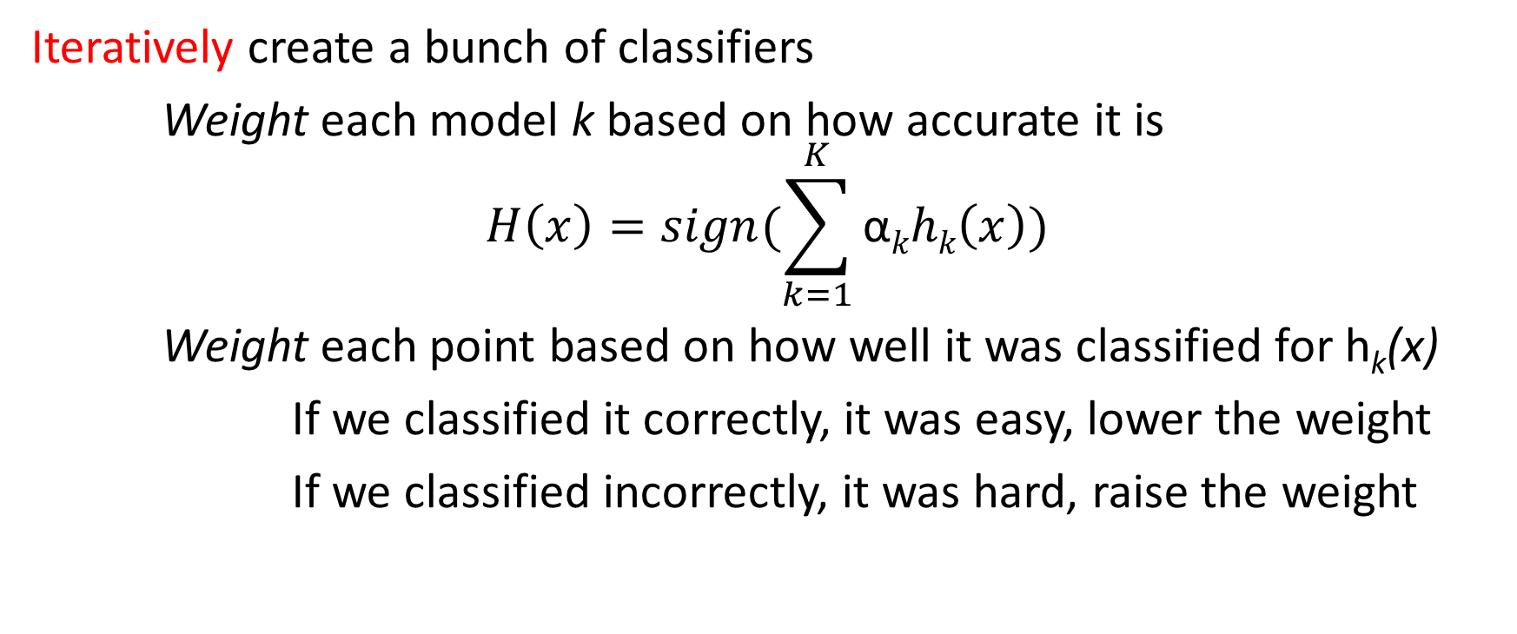
Boosting – Favoring Certain Points
Iteratively create a bunch of classifiers
Weight each model k based on how accurate it is
$$H\left(x\right)=sign(\sum_{k=1}^{K}{\text{α}khk\left(x\right)})$$
Weight each point based on how well it was classified for h_{k}(x)
If we classified it correctly, it was easy, lower the weight
If we classified incorrectly, it was hard, raise the weight

Slide 44
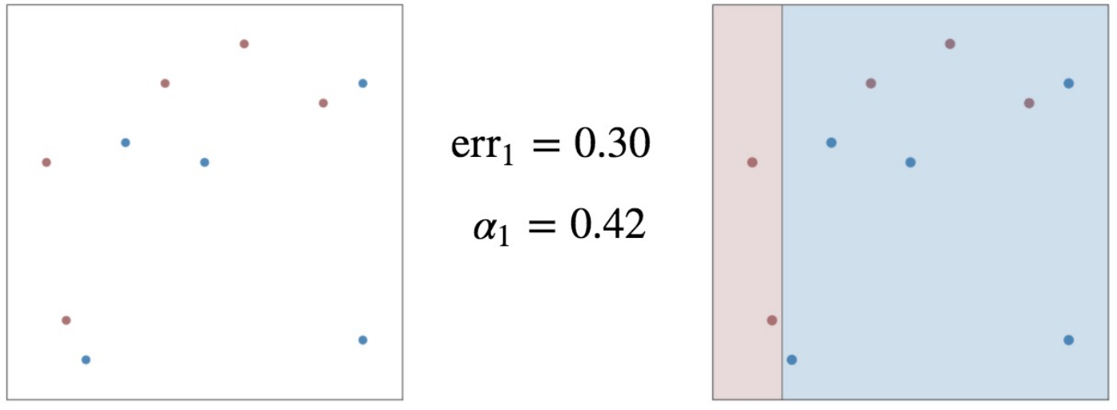
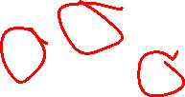
Boosting – Favoring certain Points

Slide 45
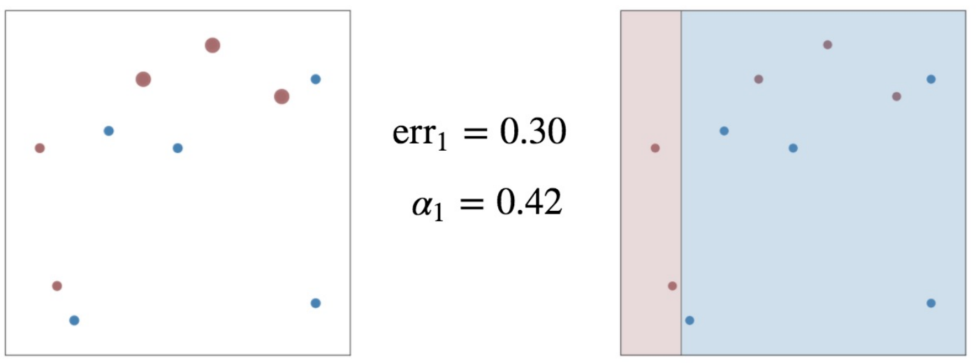

Boosting – Favoring certain Points

Slide 46
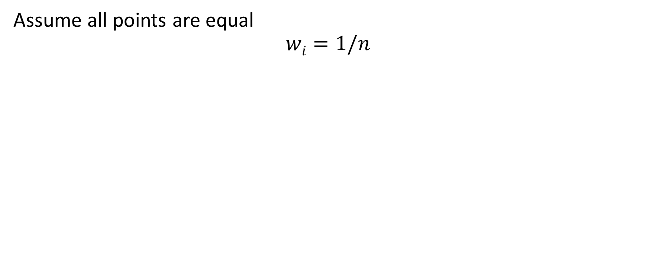
Initializing our Weights
Assume all points are equal
$$wi=1/n$$

Slide 47
Updating our Weights
Up weight for incorrect
Down weight for correct
Based on accuracy of the model

Slide 48
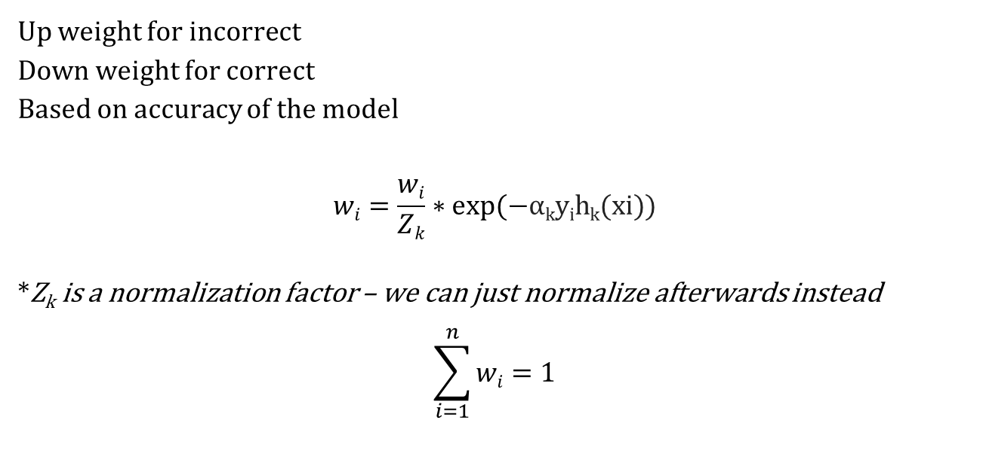
Updating our Weights - Adaboost
Up weight for incorrect
Down weight for correct
Based on accuracy of the model
$$wi=\frac{wi}{Zk}∗exp⁡(−\text{α}\text{k}\text{y}\text{i}\text{h}\text{k}\text{(}\text{xi}\text{))}$$
*Z_{k} is a normalization factor – we can just normalize afterwards instead
$$\sum_{i=1}^{n}{wi}=1$$

Slide 49
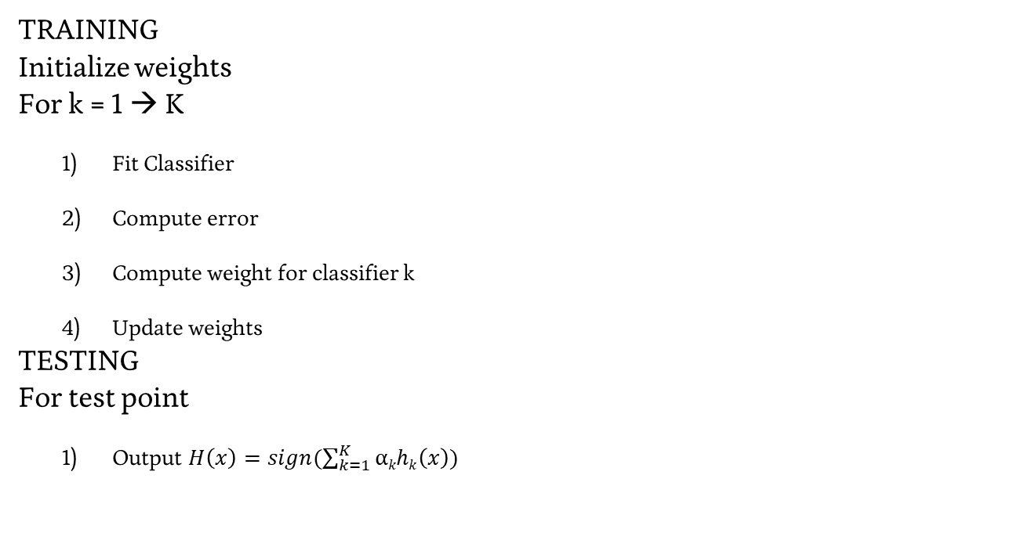
Adaboost in practice
TRAINING
Initialize weights
For k = 1 → K
Fit Classifier
Compute error
Compute weight for classifier k
Update weights
TESTING
For test point
Output $H\left(x\right)=sign(\sum_{k=1}^{K}{\text{α}khk\left(x\right)})$

Slide 50
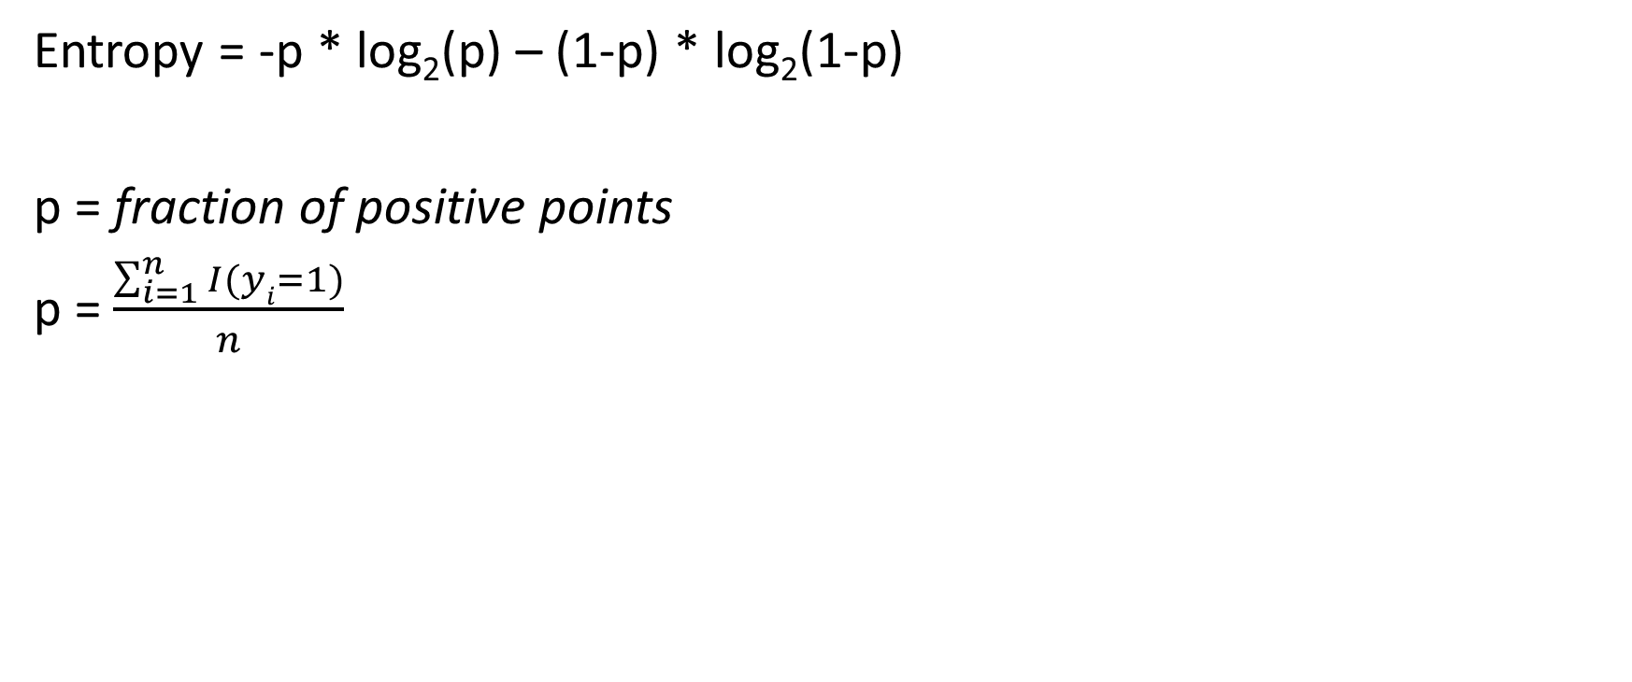
Fitting Classifier
Entropy = -p * log₂(p) – (1-p) * log₂(1-p)
p = fraction of positive points
p = $\frac{\sum_{i=1}^{n}{I(yi=1)}}{n}$

Slide 51
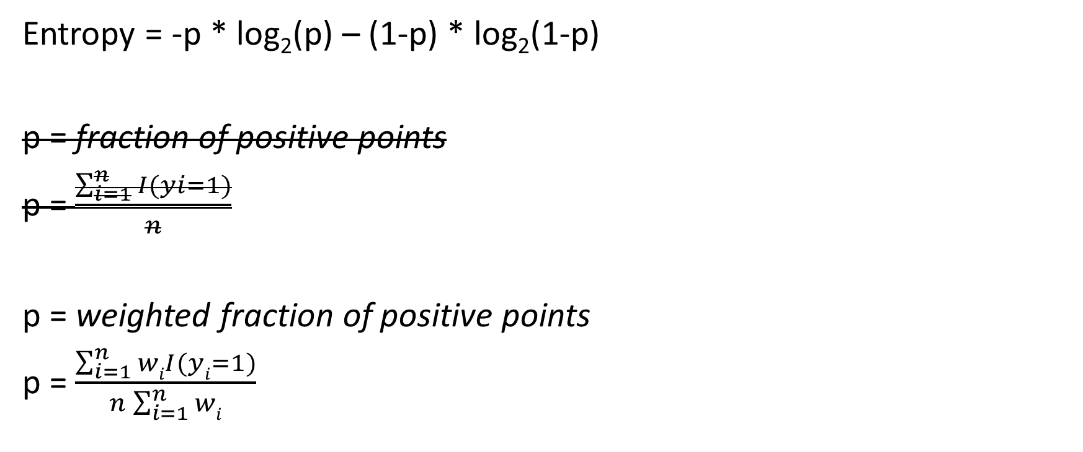
Fitting Classifier
Entropy = -p * log₂(p) – (1-p) * log₂(1-p)
p = fraction of positive points
p = $\frac{\sum_{i=1}^{n}{I(yi=1)}}{n}$
p = weighted fraction of positive points
p = $\frac{\sum_{i=1}^{n}{wiI(yi=1)}}{n\sum_{i=1}^{n}{wi}}$

Slide 52

Weights for Individual Classifiers
$$err= \frac{\sum_{i=1}^{m}{I(yi ≠h\left(xi\right))}}{m}$$

Slide 53

Weights for Individual Classifiers
$$err= \frac{\sum_{i=1}^{m}{I(yi ≠h\left(xi\right))}}{m}$$
$$err= \frac{\sum_{i=1}^{m}{wiI(yi ≠h\left(xi\right))}}{\sum_{i=1}^{m}{wi}}$$

Slide 54
Adaboost in practice
TRAINING
Initialize weights
For k = 1 → K
Fit Classifier
Compute error
Compute weight for classifier k
Update weights
TESTING
For test point
Output $H\left(x\right)=sign(\sum_{k=1}^{K}{\text{α}khk\left(x\right)})$

Slide 55
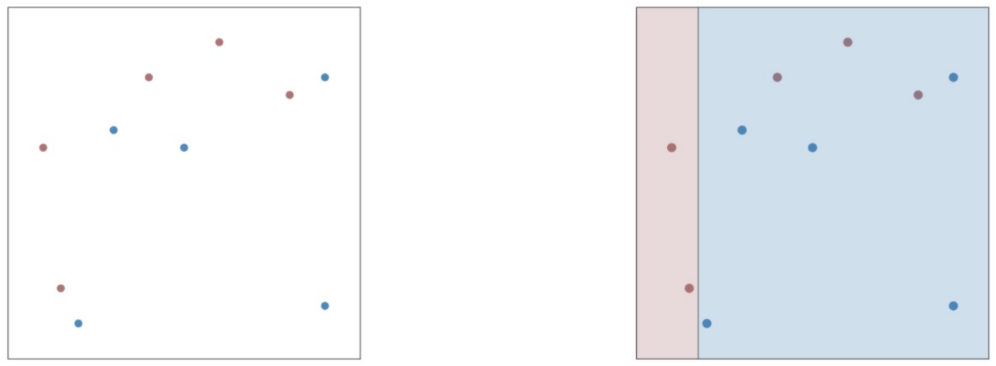
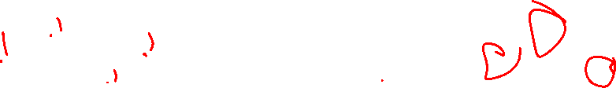
Adaboost – Working Example
First Decision Stump

Slide 56
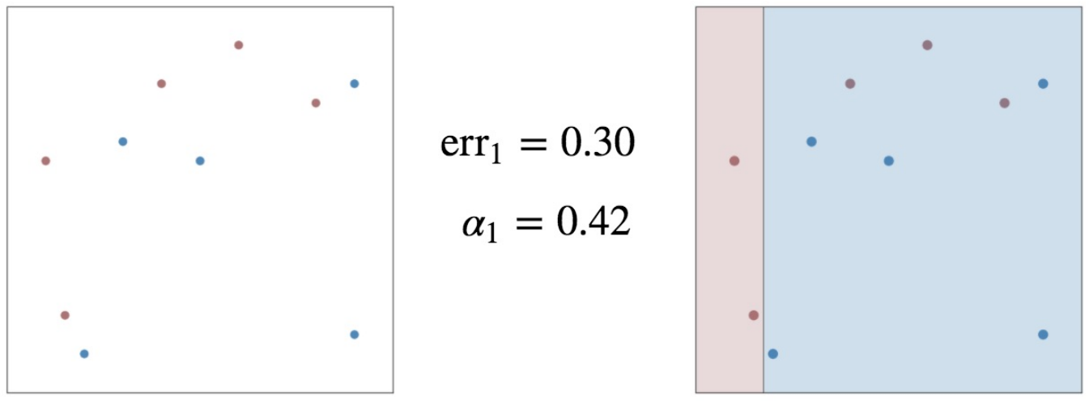

Adaboost – Working Example
First Decision Stump

Slide 57
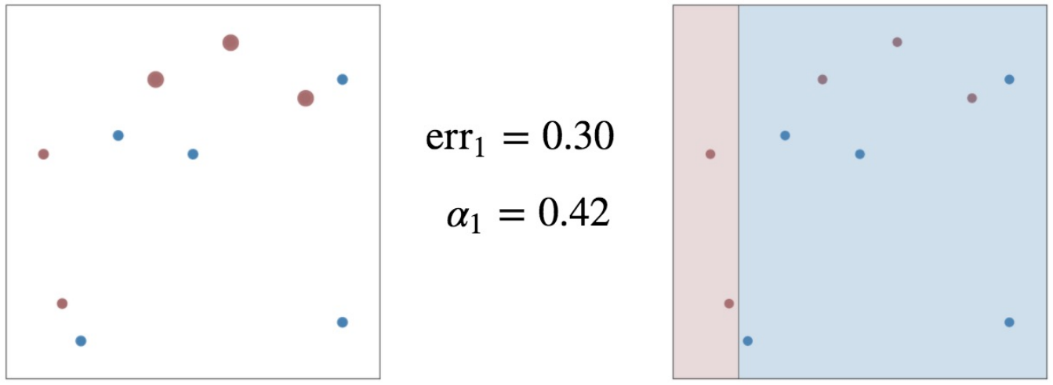
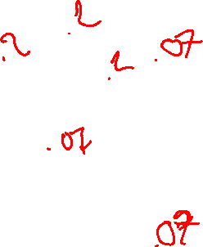
Adaboost – Working Example
First Decision Stump

Slide 58
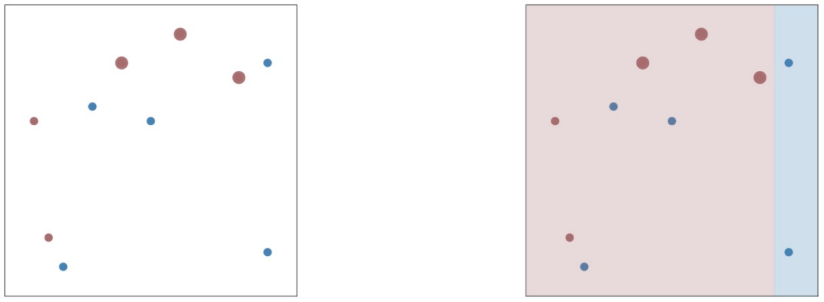
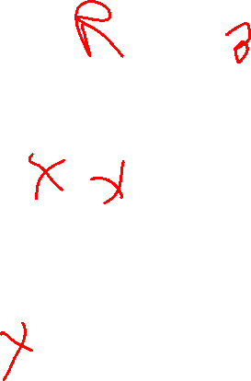
Adaboost – Working Example
Second Decision Stump

Slide 59
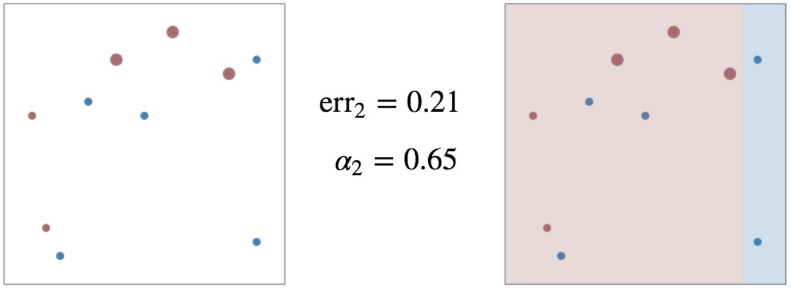
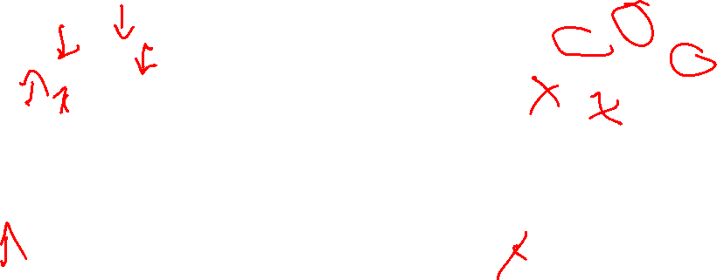
Adaboost – Working Example
Second Decision Stump

Slide 60
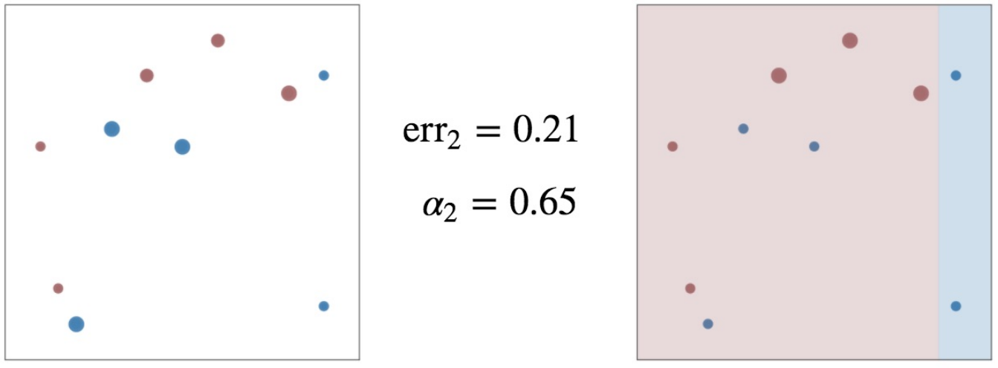
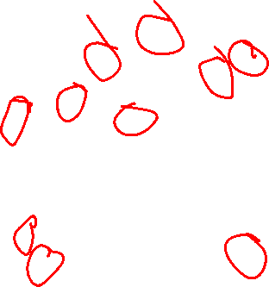
Adaboost – Working Example
Second Decision Stump

Slide 61
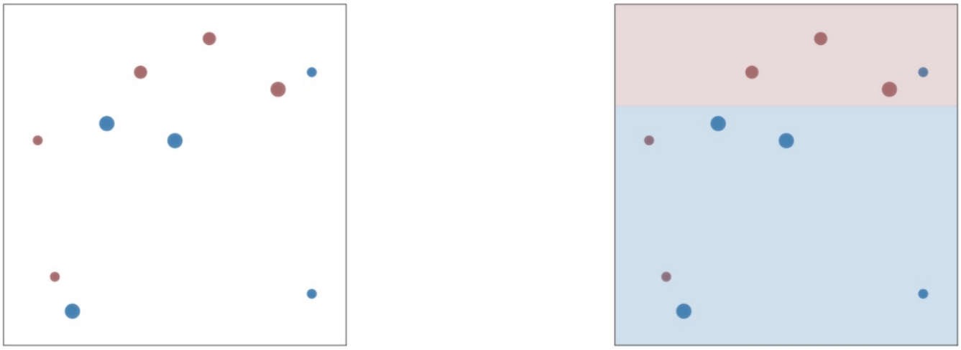
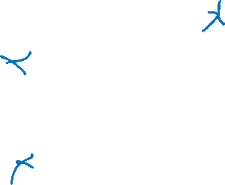
Adaboost – Working Example
Third Decision Stump

Slide 62
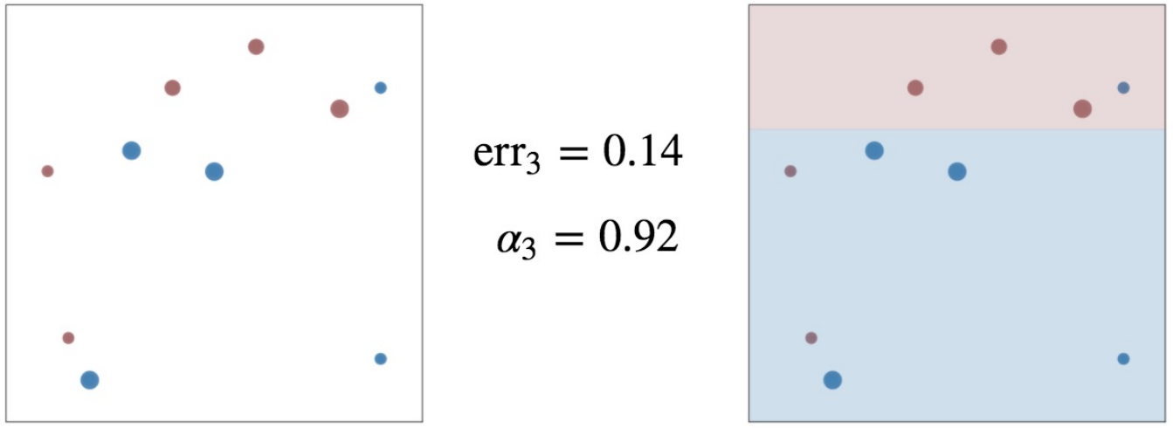
Adaboost – Working Example
Third Decision Stump

Slide 63
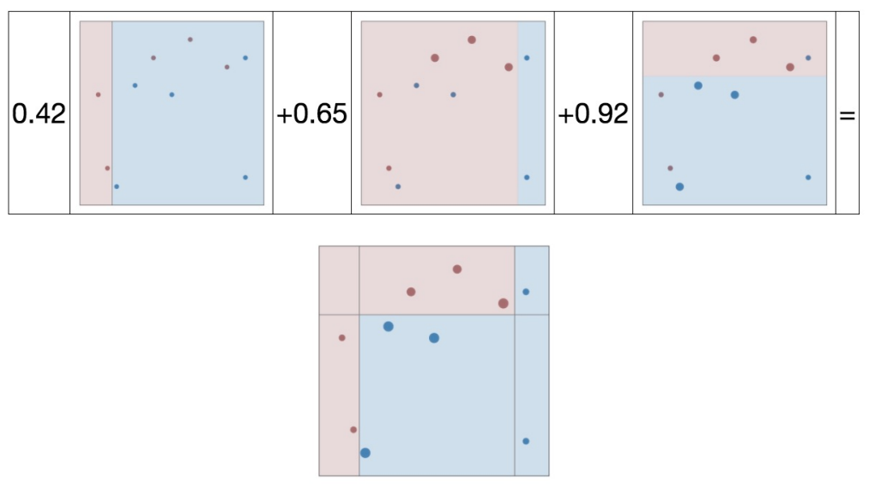

Adaboost – Working Example
Final Ensemble Model

Slide 64
Adaboost – Working Example
Final Ensemble Model

Slide 65

Boosting - Benefits
Reducing the variance?
Variance – Sensitivity to the training set
Reducing the bias?
Bias – Sensitivity to the model

